Slide 1
PowerPoint 3: Canadian Journey security features
Lesson 1-2

Slide 2
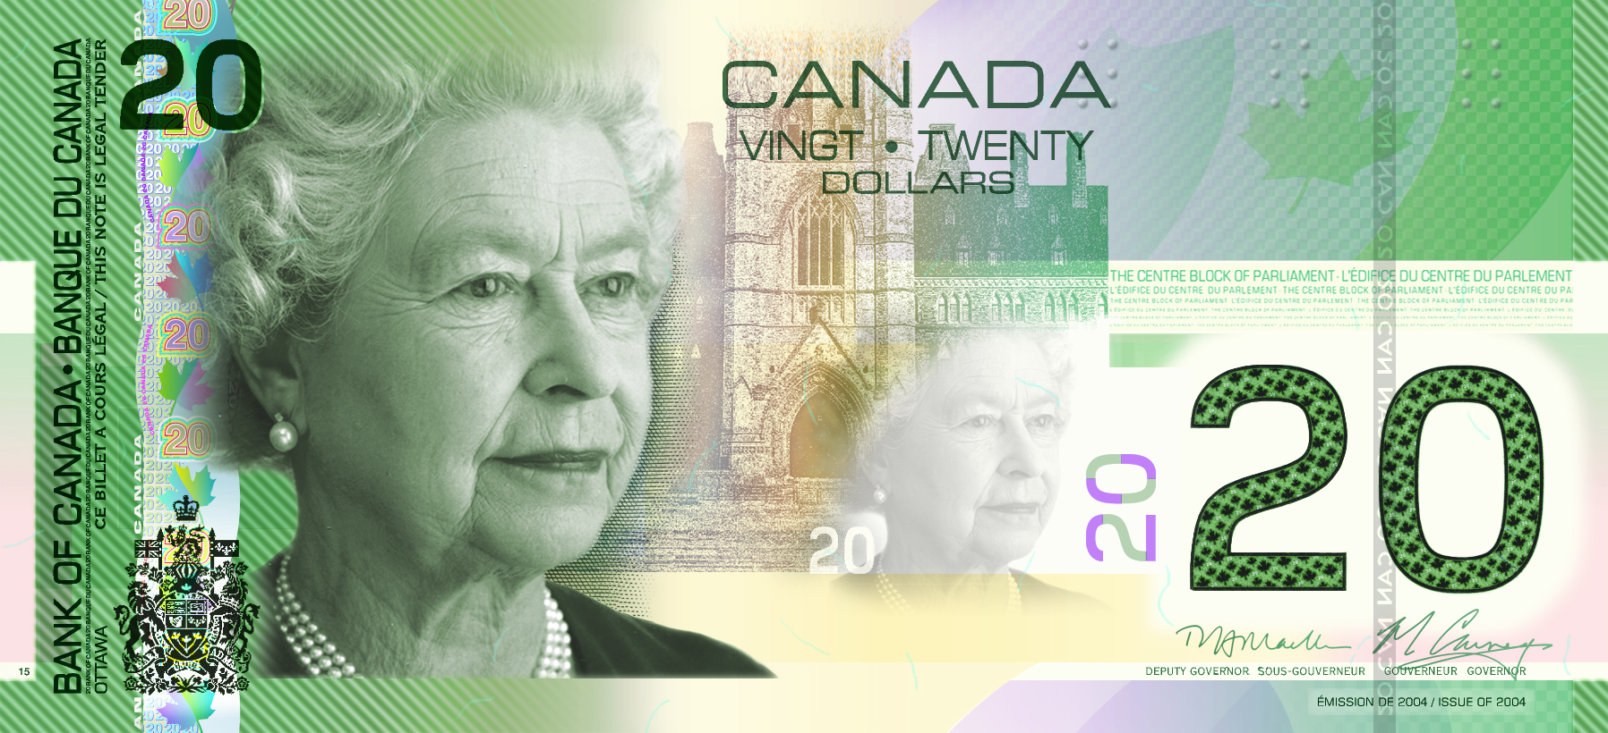
Security features at a glance
Metallic stripe
Ghost image
Puzzle number
Raised ink
Dashes
Notes:
The paper notes of the Canadian Journey series (with a metallic stripe) will continue to be around for some time.
Remember that all the notes in this series share the same security features. Here’s what to look for:
metallic stripe
ghost image
puzzle number
dashes
raised ink
Note: The original $5 and $10 notes of the Canadian Journey series had different security features than those described here. Instead of a metallic stripe, they featured iridescent maple leaves. The new versions of the $5 and $10 notes, issued in 2006 and 2005, respectively, have the same security features as the $20, $50 and $100 notes.

Slide 3
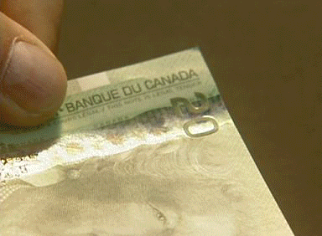
Metallic stripe
Tilt the note back and forth. The numbers and maple leaves change colour.
Notes:
One of the most important security features of the Canadian Journey series is the metallic stripe to the left of the large portrait.
Tilt the note back and forth to see the numbers and maple leaves change colour through the various shades of the rainbow.
It’s not enough to notice that the bill has a metallic stripe. Make sure the fine details and colour shifts are accurate. Make sure the numbers in the stripe match the value of the note.

Slide 4
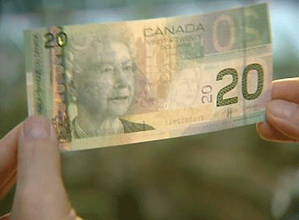
Ghost image
Hold the note up to the light and look through it. A small, ghost-like image of the portrait appears.
Notes:
This image is visible from both sides of the note.
When the note is not held up to the light, this area looks like a blank space and the ghost image is not visible.

Slide 5
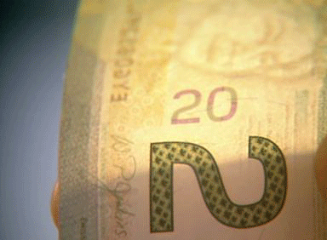
Puzzle number
Hold the note up to the light and look through it. Irregular marks on the front and back of the note form a complete number.
Notes:
Irregular marks appear on both the front and back of the note, next to the area containing the ghost image.
Hold the note up to the light and look through it. The irregular marks come together like a puzzle to form a complete number matching the note’s value.
This number is visible from both sides of the note.

Slide 6
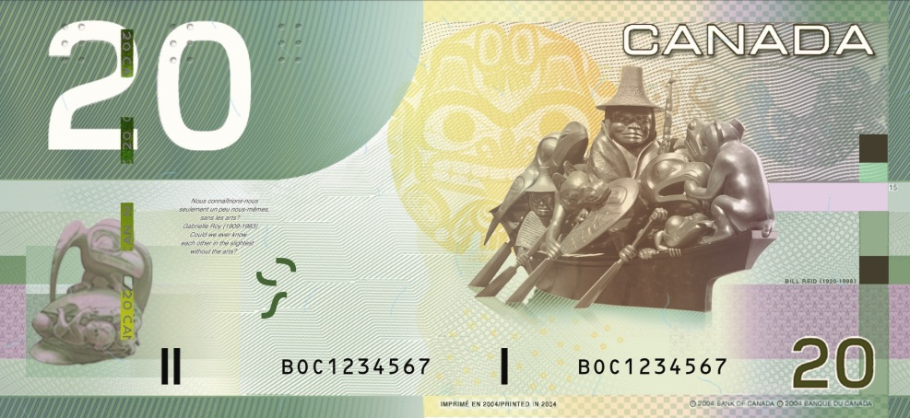
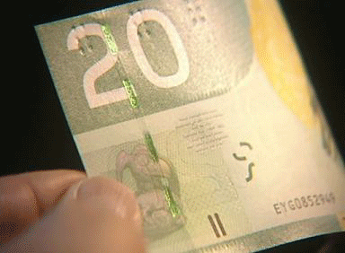
Dashes
Tilt the note:
Dashes shift from gold to green.
Small characters match the note’s value.
Notes:
The dashes are located close to the large number on the back of the note. They look like they are woven in and out of the paper.
Tilt the note back and forth to see the dashes shift from gold to green.
Any other colour shift, or no colour shift, means that you probably have a counterfeit note.
Small characters, for example “CAN 20,” match the note’s value.

Slide 7
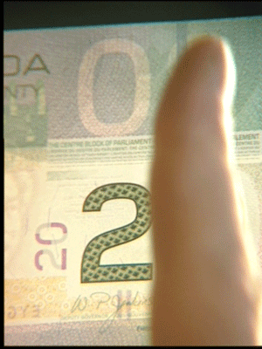
Dashes
Hold the note up to the light and look through it. The dashes form a solid line.
Notes:
When you hold the note up to the light and look through it, the dashes form a solid line running from the top to the bottom of the note.
The line is visible from both sides of the note.
To recap this feature:
the colour shifts from gold to green
the number printed on the dashes matches the note’s value
the dashes form a solid line when the note is held up to the light
Counterfeits are not likely to include all three of these details.

Slide 8
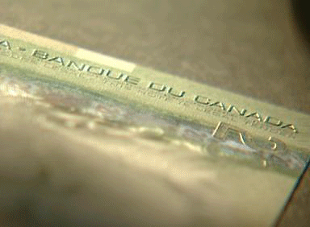
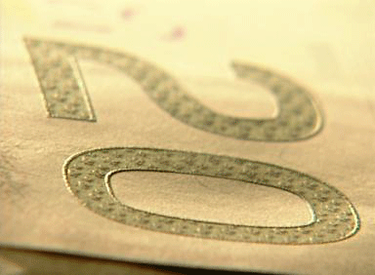
Raised ink
Feel the raised ink.
Notes:
When you handle cash on the job every day, you get to know what real money feels like. Genuine paper bank notes do not feel like regular paper because they are printed on material made of 100 per cent cotton. Sometimes, the general feel of a fake bill can be your first clue that something is wrong. If so, then be sure to check the security features to confirm your suspicion.
Several areas of each bank note are printed with raised ink. You can feel the raised ink on:
the large number
the shoulder of the large portrait
the words “Bank of Canada • Banque du Canada”

