Slide 1
PowerPoint 2:
Images of the
front and back of a
polymer note
Lesson 1-2

Slide 2
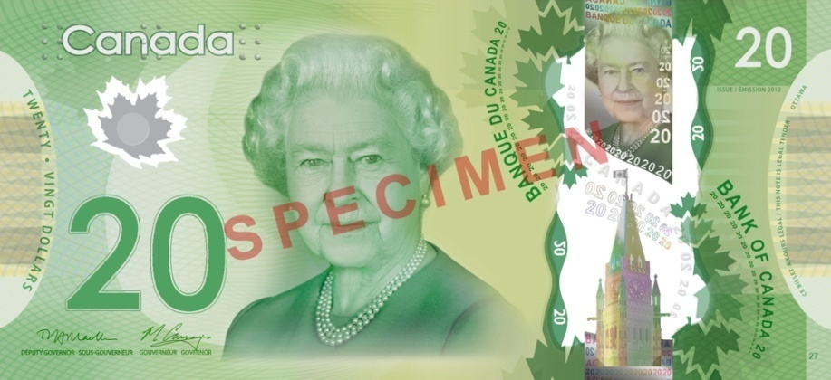
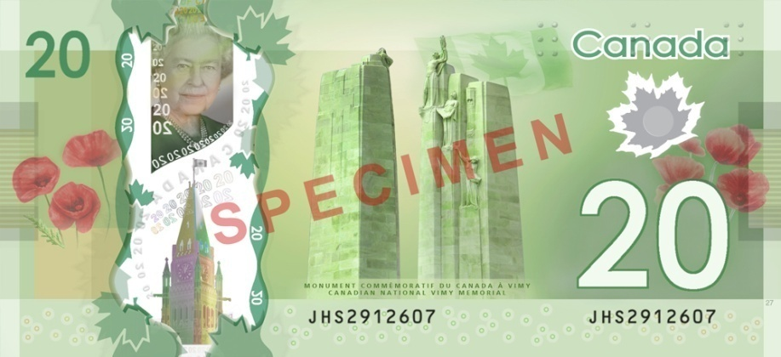
Polymer series

Slide 3

Polymer series

Slide 4

Polymer series

