Slide 1
PowerPoint 1: Images of
bank notes
Lesson 1-1

Slide 2
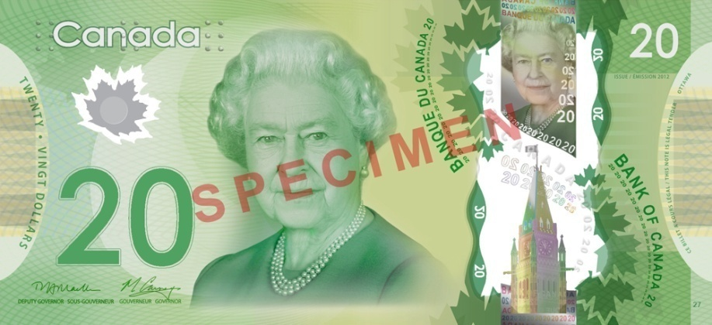
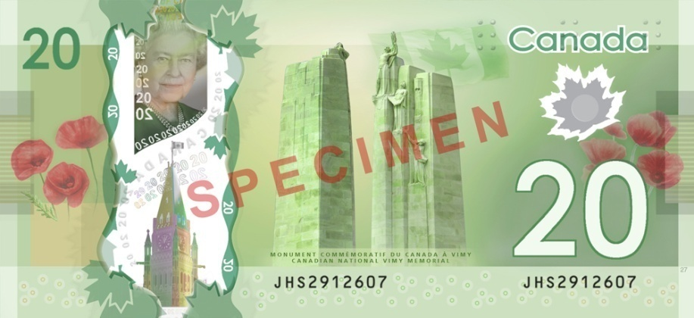
Polymer series

Slide 3
Polymer series

Slide 4
Polymer series

Slide 5
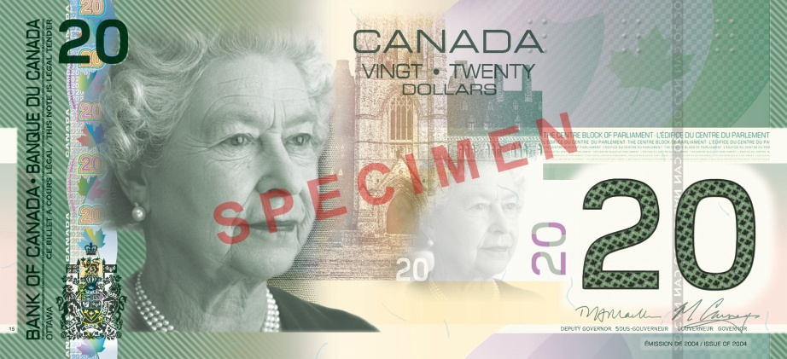
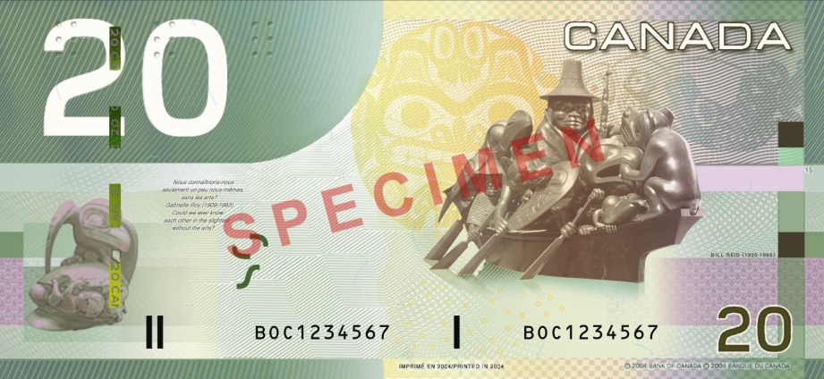
Canadian Journey series

Slide 6
Canadian Journey series

Slide 7
Canadian Journey series

